Slide 1
Deep Reinforcement Learning, DRL && Graph Neural Networks, GNN
Markov Game and MARL Architectures
Graph Theory → Graph Signal Processing → Graph Convolutional Network
1609.《Semi-Supervised Classification with Graph Convolutional Networks》
2206.《Challenges and Opportunities in Deep Reinforcement Learning with Graph Neural Networks: A Comprehensive review of Algorithms and Applications》
2106.《Graph Neural Network and Reinforcement Learning for Multi-agent Cooperative Control of Connected Autonomous Vehicles》

Slide 2
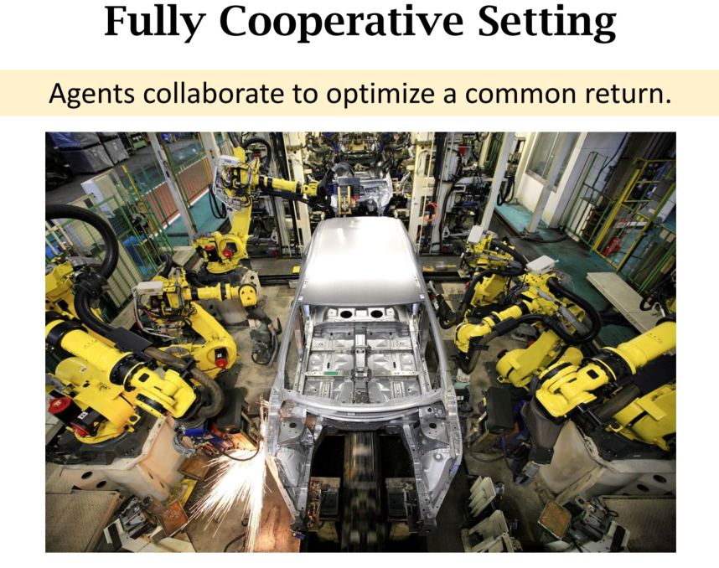
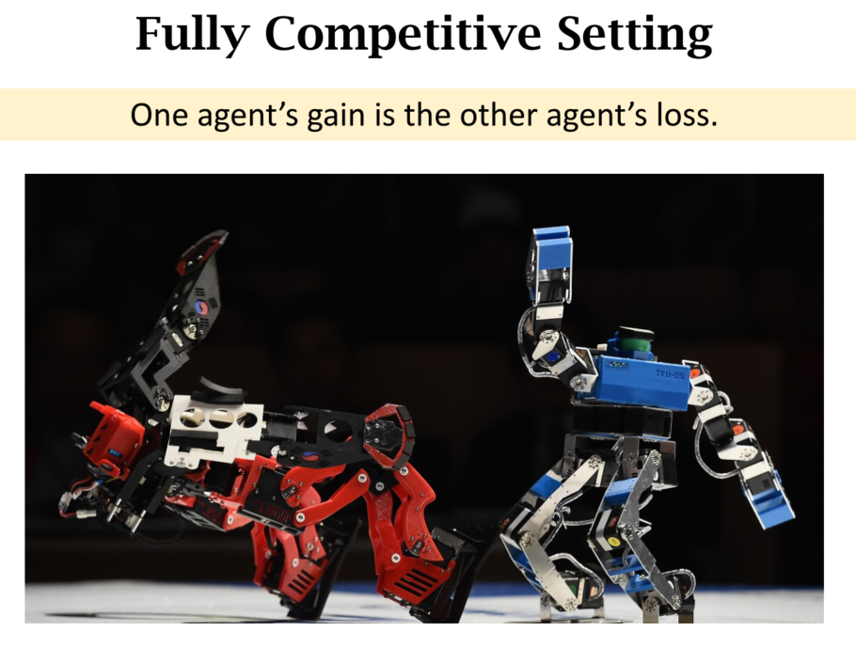
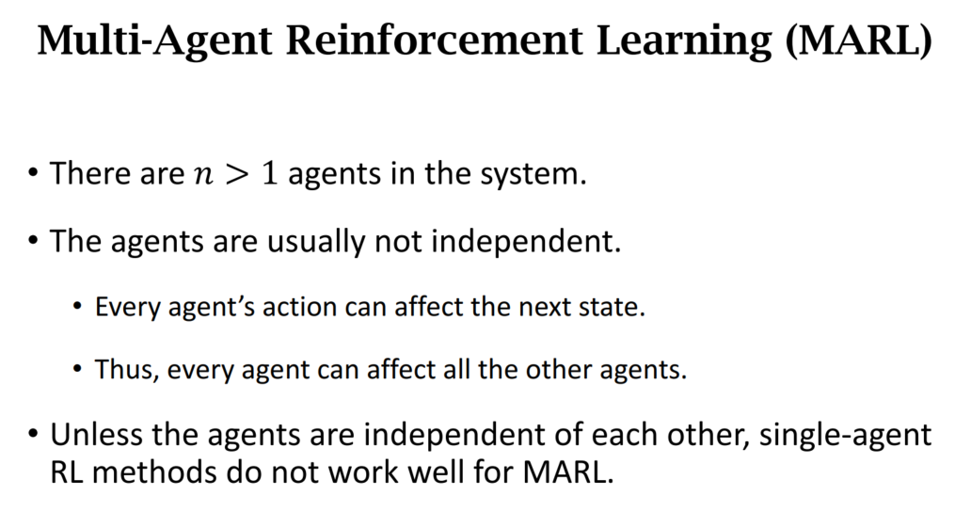
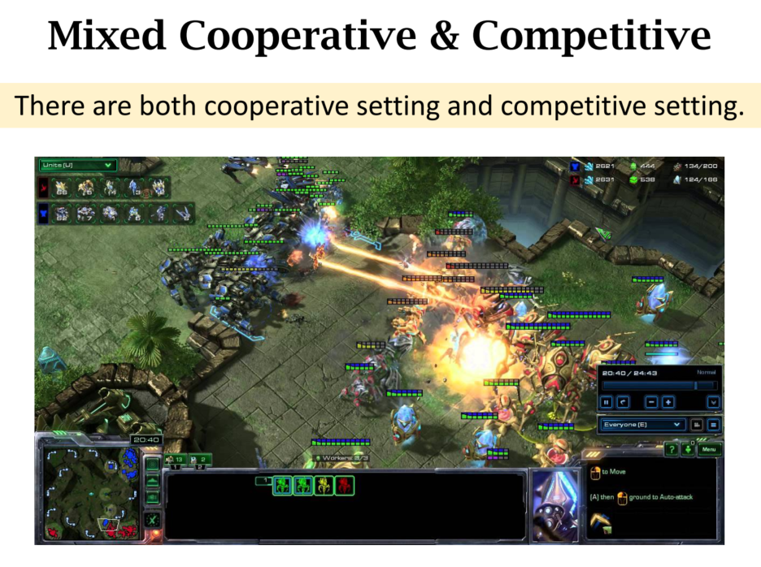
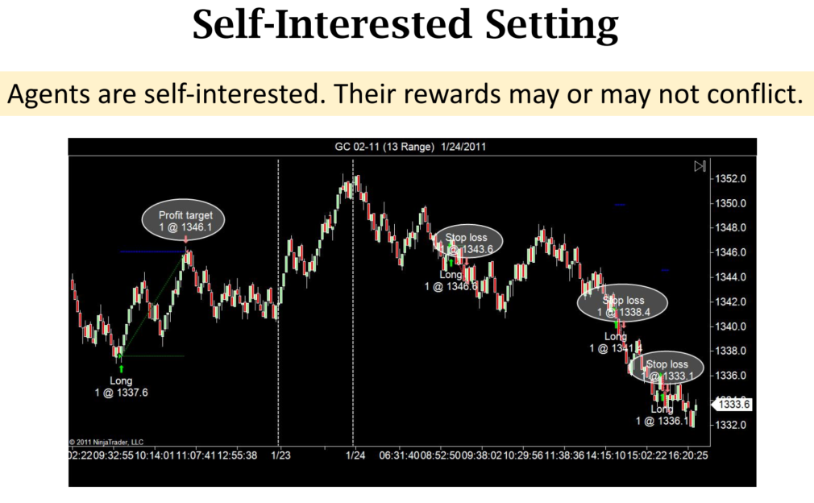
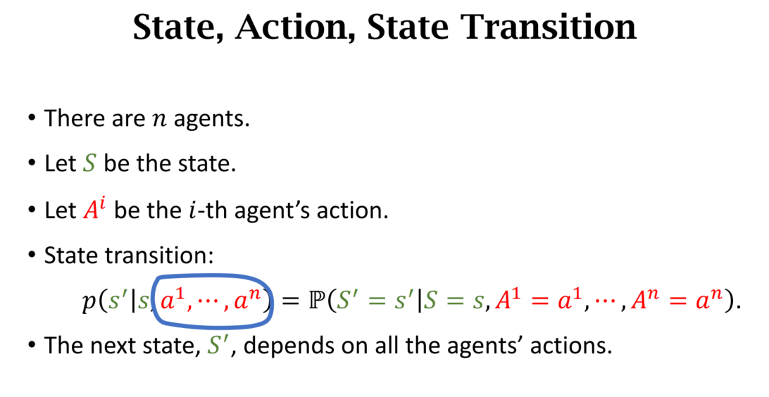
Markov Game and MARL Architectures

Slide 3
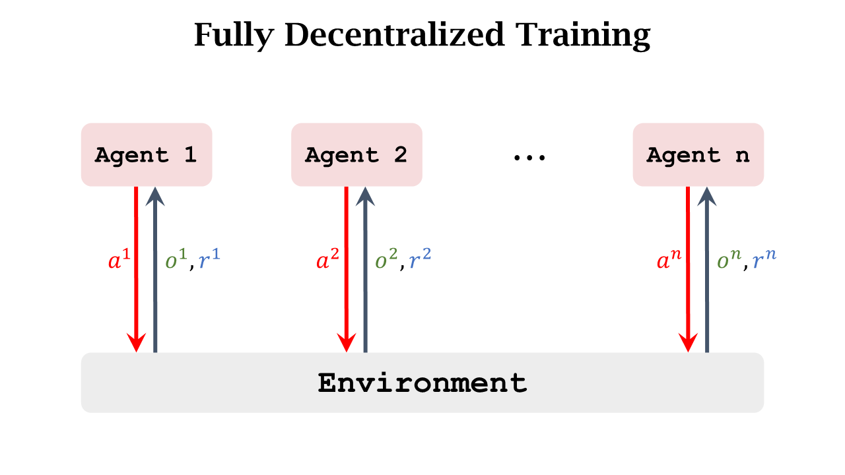
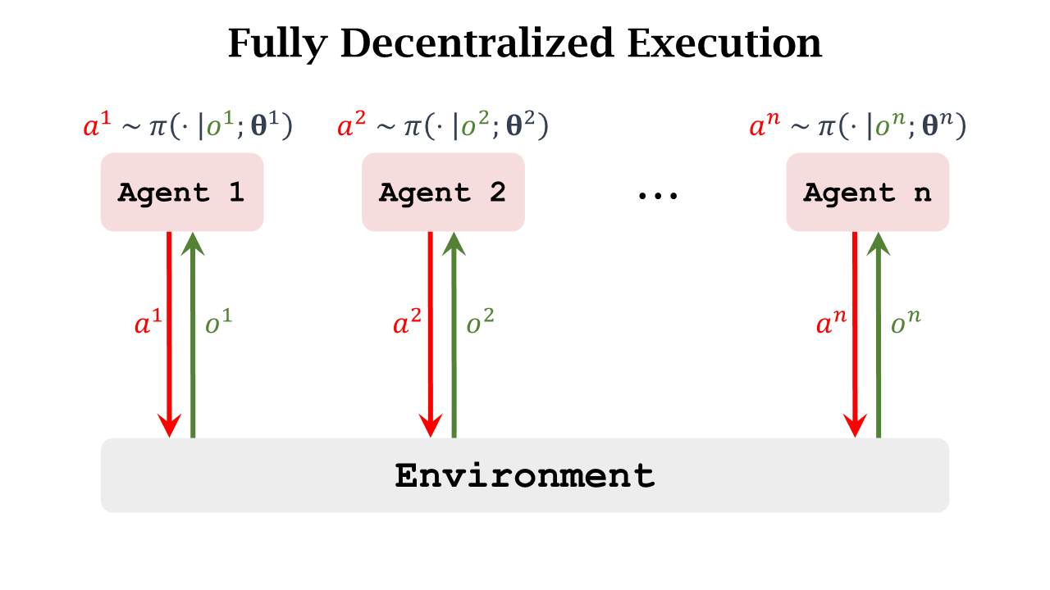
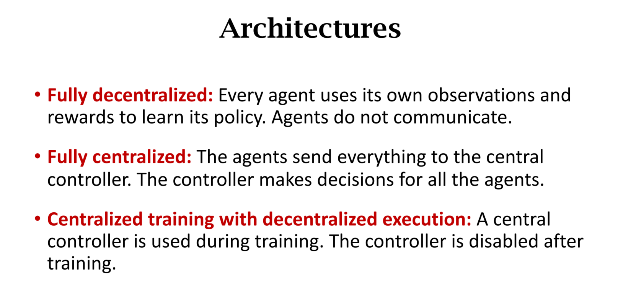
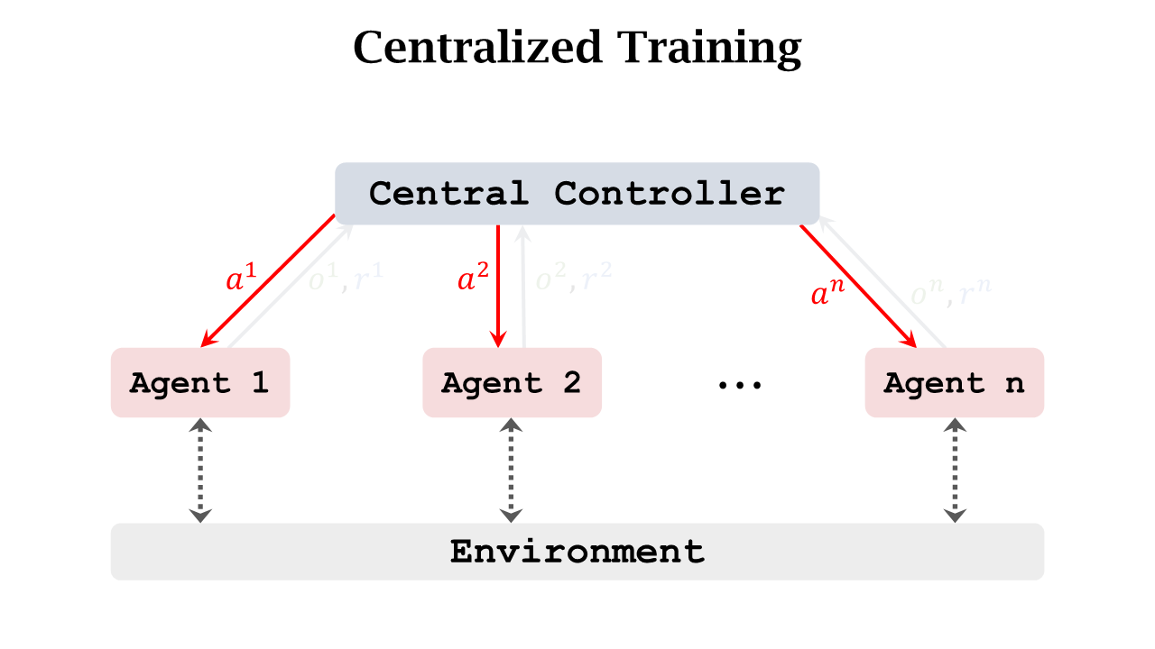
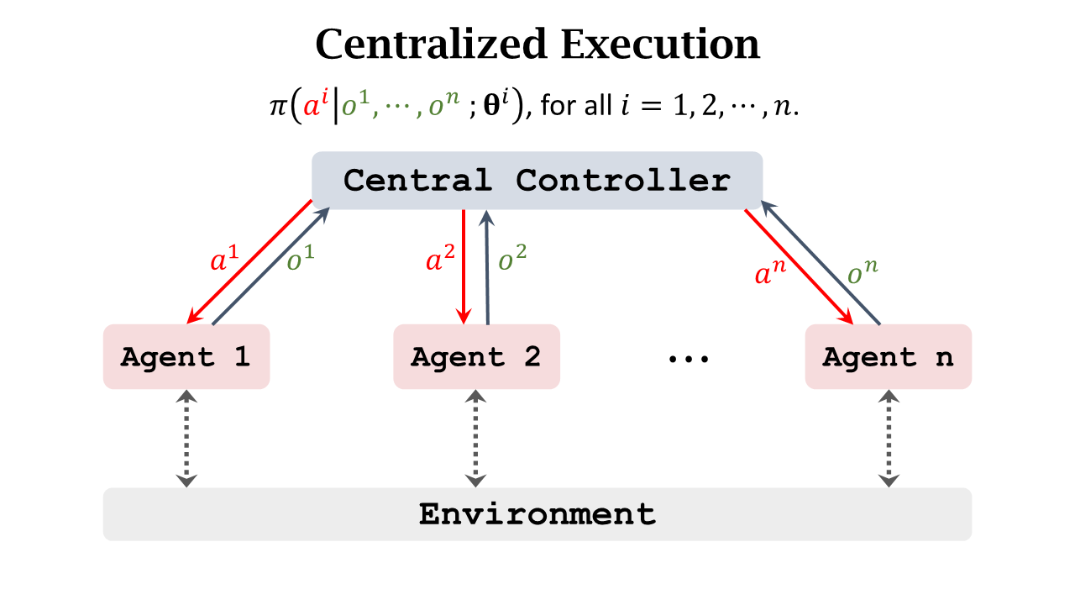
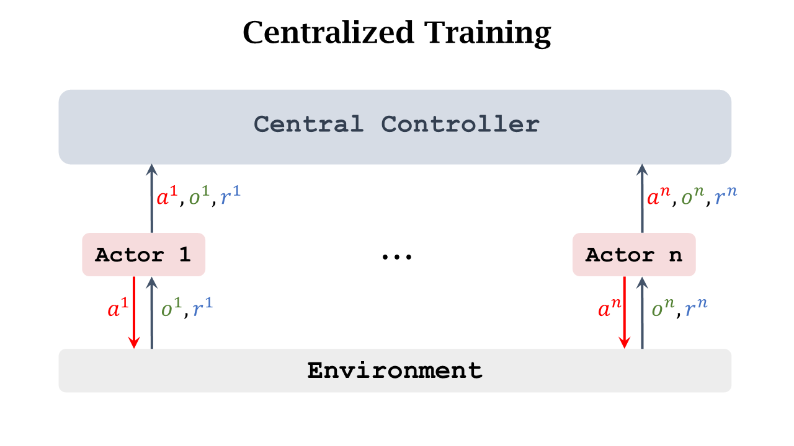
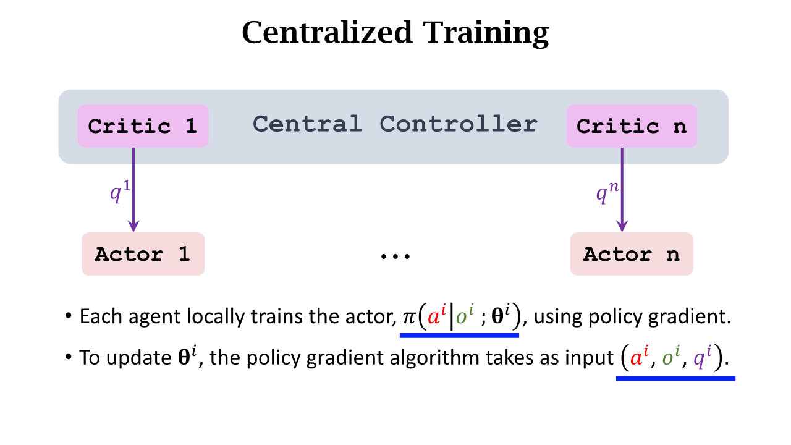
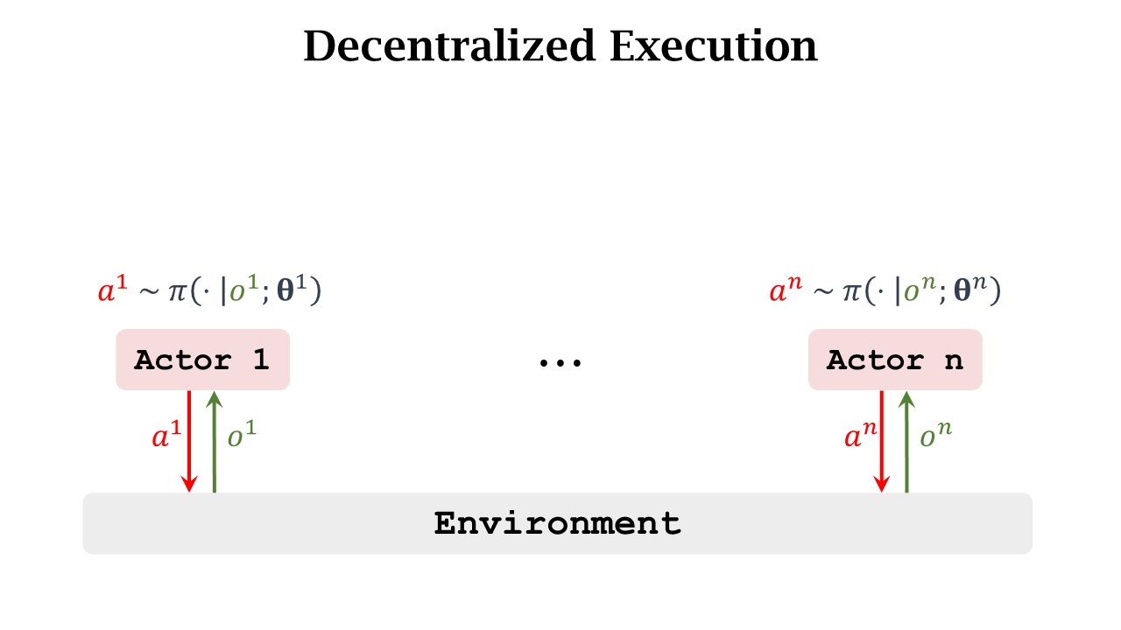

Slide 4
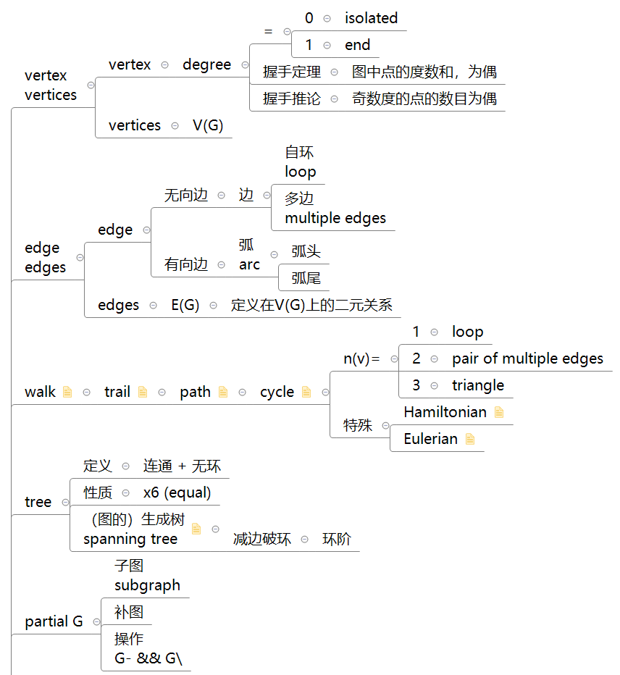
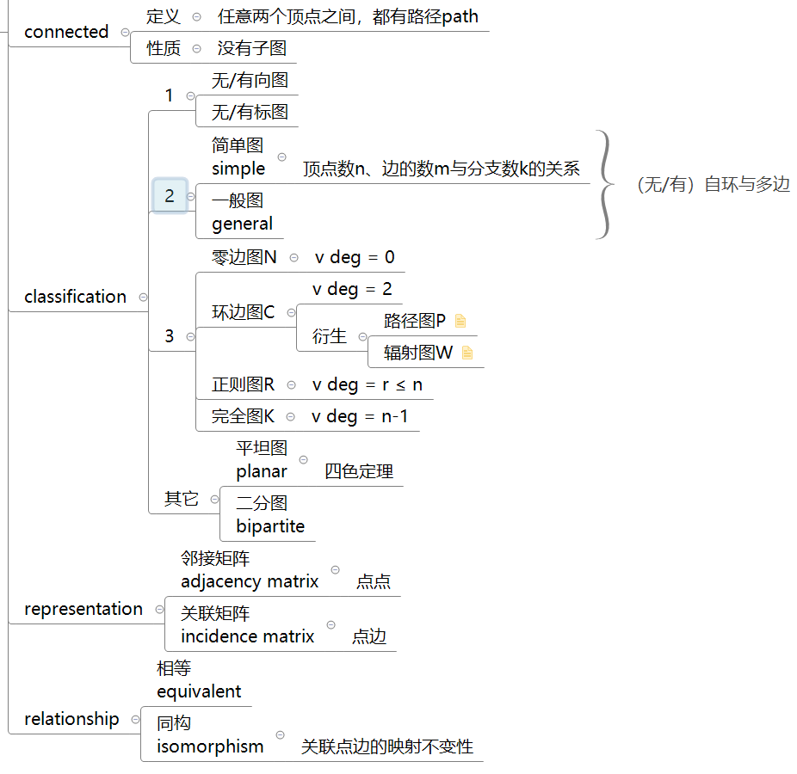
《Introduction to Graph Theory》 Robin J. Wilson
v2/s2
e1
v3/s3
v1/s1
e2
e3
v4/s4

Slide 5

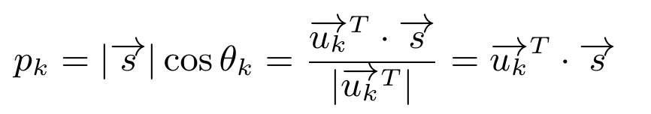
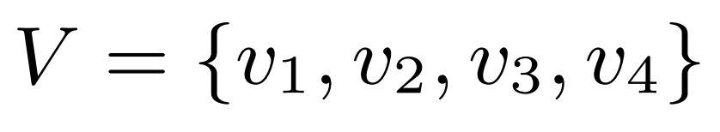
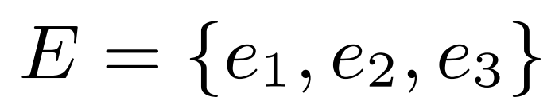

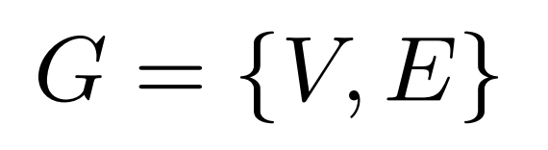

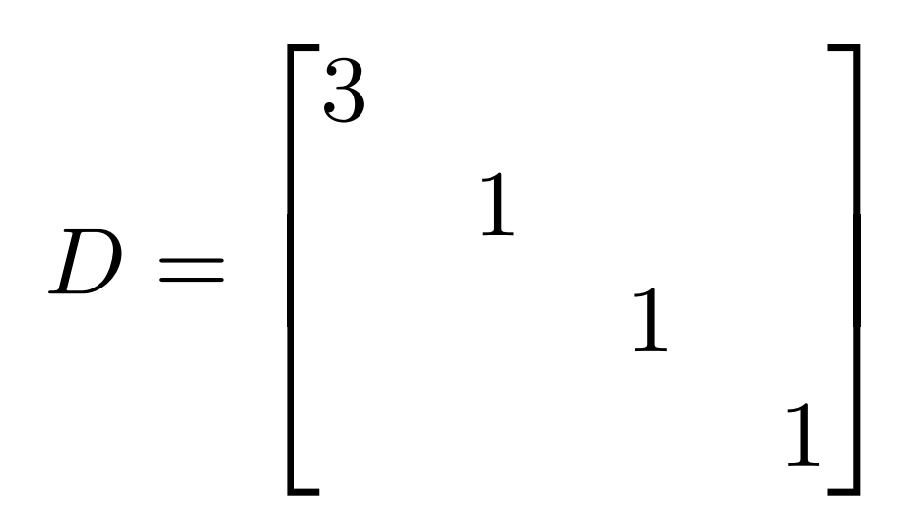

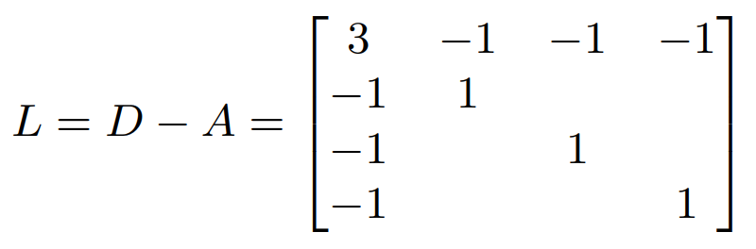
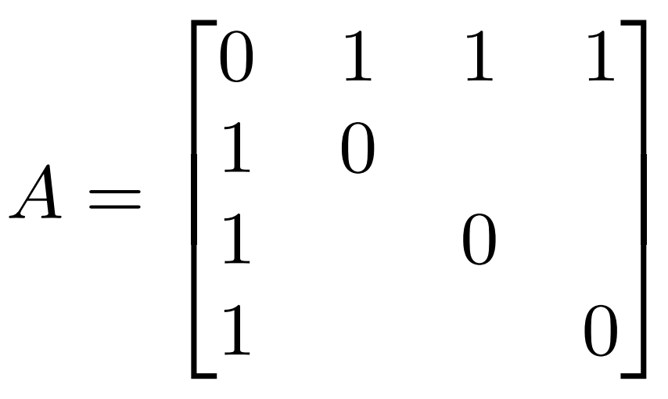
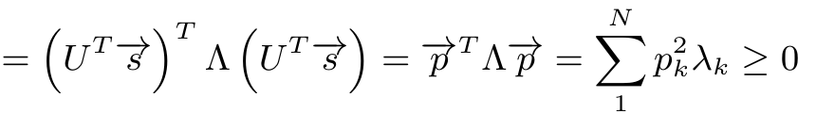
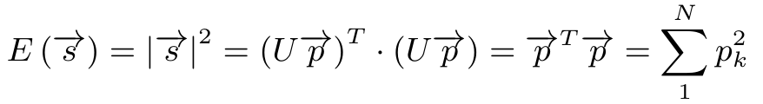
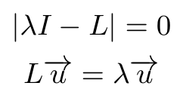
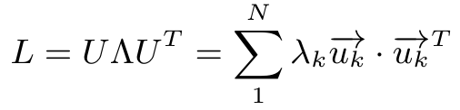
Graph Signal Processing
v2/s2
e1
v3/s3
v1/s1
e2
谱
e3
谱图理论(Spectral Graph Theory)
v4/s4
幅
图
频
能量

Slide 6
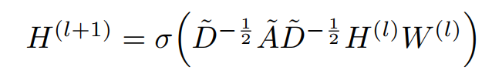
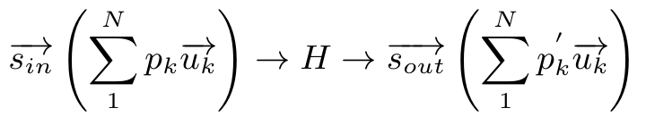


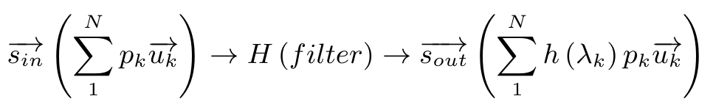

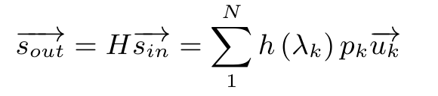
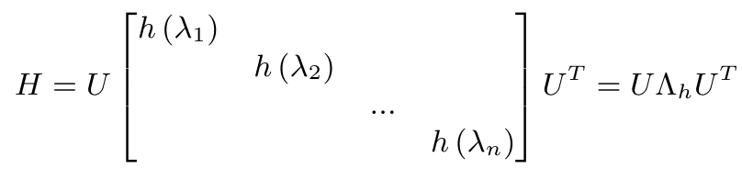
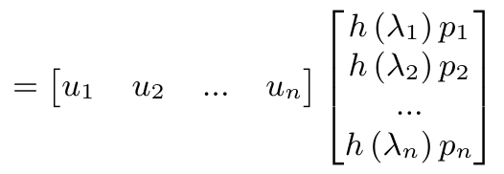
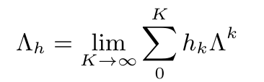


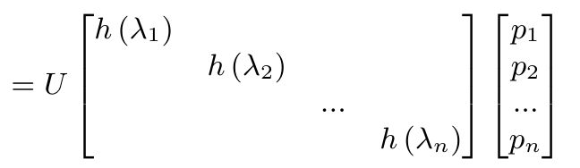
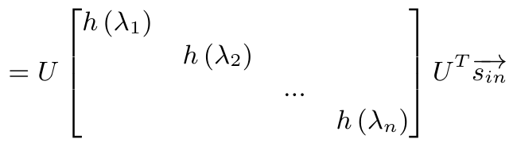
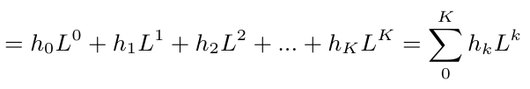


《Semi-Supervised Classification with Graph Convolutional Networks》
s2
s2’
s3
s3’
s1
s1’
s4
s4’
GCN

Slide 7
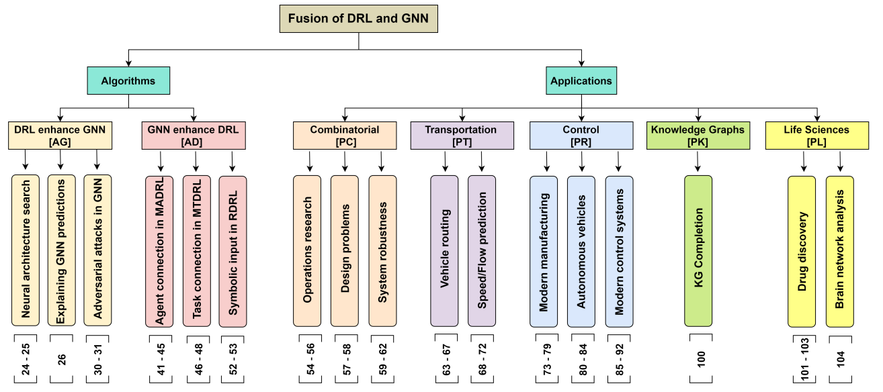
2206.《Challenges and Opportunities in Deep Reinforcement Learning with Graph Neural Networks: A Comprehensive review of Algorithms and Applications》
which finally led to 40 papers. There are no relevant papers before 2017
1.Neural Architecture Search (NAS)
optimal architecture
Relational DRL (RDRL)
1.Agent Connection in MADRL
2.Explaining GNN Predictions
starts with a seed node and adds edges
2.Task Connection in MTDRL
3.Relational Symbolic Input for RDRL
wherein states, actions and policies
are represented by a first-order/relational language
3.Generating Adversarial Attacks for GNN
perturb or poison the data

Slide 8
2206.《Challenges and Opportunities in Deep Reinforcement Learning with Graph Neural Networks: A Comprehensive review of Algorithms and Applications》
Combinatorial Optimization (CO)
Transportation
Manufacturing and Control
Knowledge Graphs
1.Operations Research
1.Vehicle Routing
TSP(Navigation)
1.Modern Manufacturing machines(nodes), material flow(links)
Life Sciences
2.Design Problems
Electronic Circuit Design
2.Autonomous Vehicles
1.Drug Discovery AlphaFold
2.Speed/Flow Prediction
Internet of Vehicles
Traffic Signal Control
3.Modern Control Systems
Underwater Wireless Networks
3.System Robustness
2.Brain Network Analysis

Slide 9
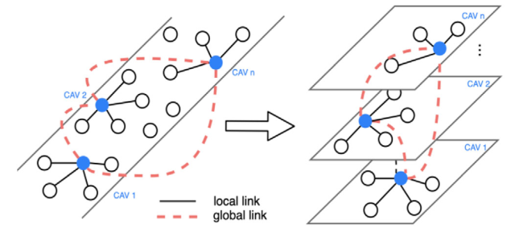
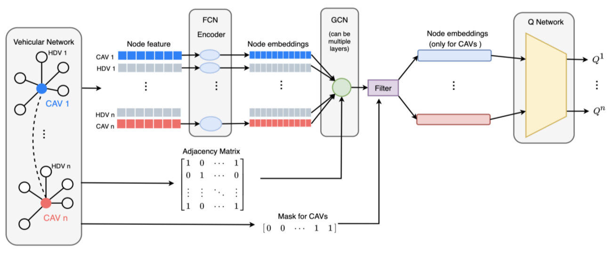






2106.《Graph Neural Network and Reinforcement Learning for Multi-agent Cooperative Control of Connected Autonomous Vehicles》
CAV: Connected Autonomous Vehicle network HDV: Human-Driven Vehicles

Slide 10
感谢听取报告！ 请批评指正！

